Slide 1

EUPHORIA
JERVIN E. PONTILLAS
WEB DEVELOPER

Slide 2
What is Euphoria? Euphoria is a website where you browse and read some posts, that will ease the uncertainty or the feelings you hide. By reading some poems, it will help you be a better person, and also, you can post your own poems too.
Project introduction

Slide 3
EUPHORIA HOME PAGE
BROWSE
ABOUT
CONTACT US
1st level

Slide 4
ABOUT
POETS
DEVELOPERS
SUBMISSIONS
2nd level

Slide 5
WEBSITE SCREEN LAYOUT

Slide 6

Sample Homepage Layout

Slide 7
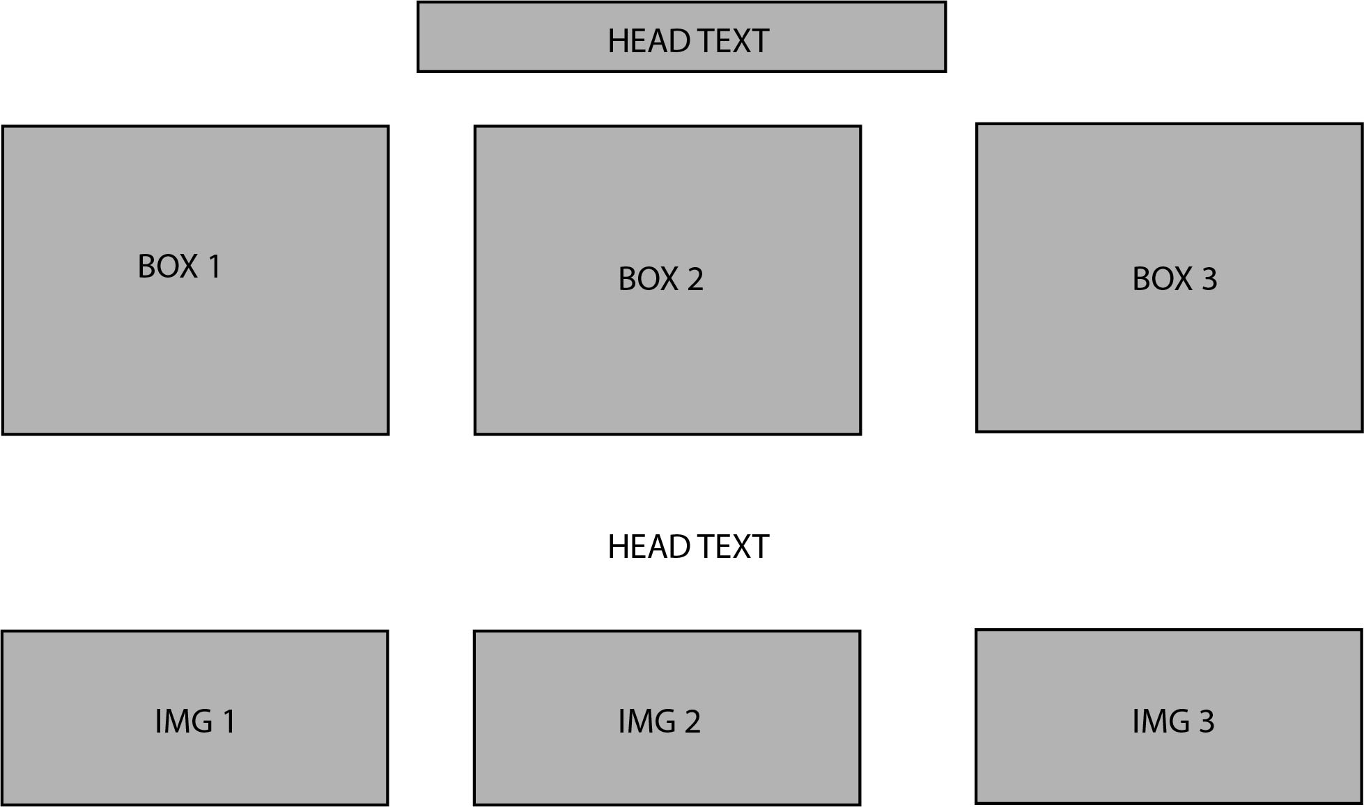

Slide 8
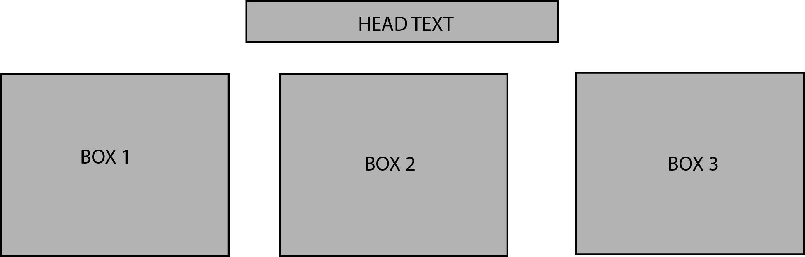
Poems, Poets, Developers Page Layout

Slide 9
Sample Screenshots

Slide 10


Slide 11
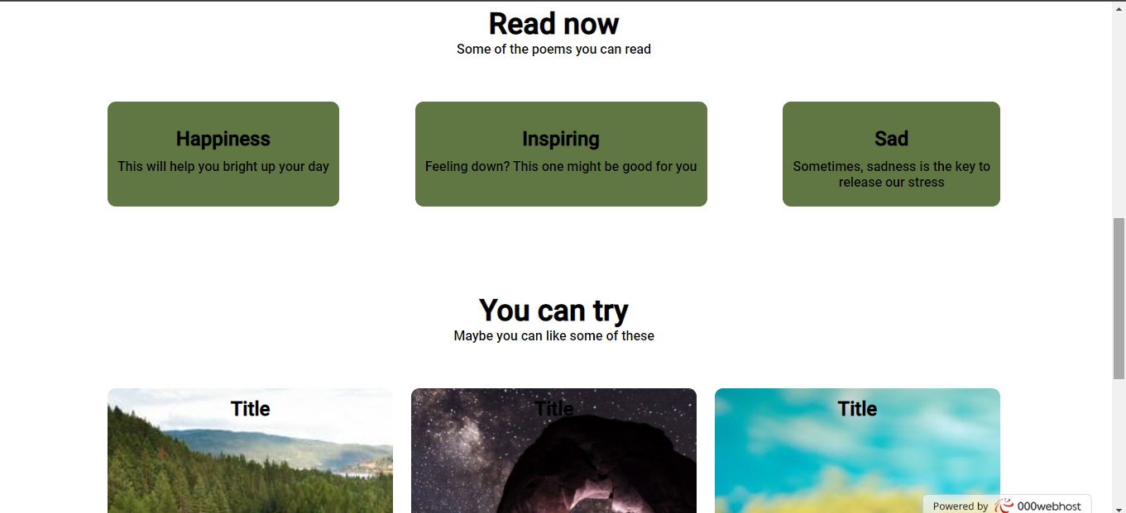

Slide 12
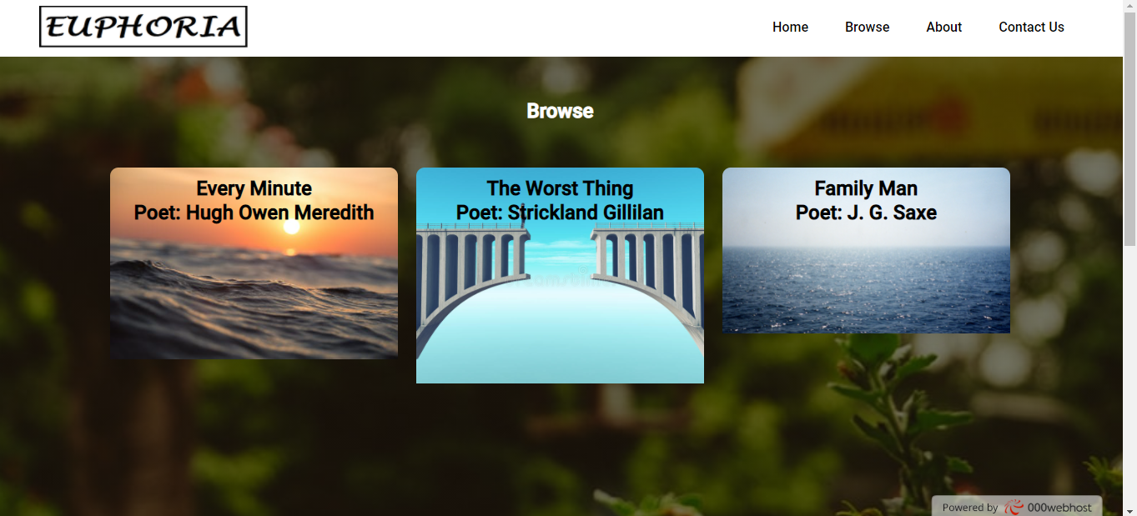

Slide 13


Slide 14


Slide 15
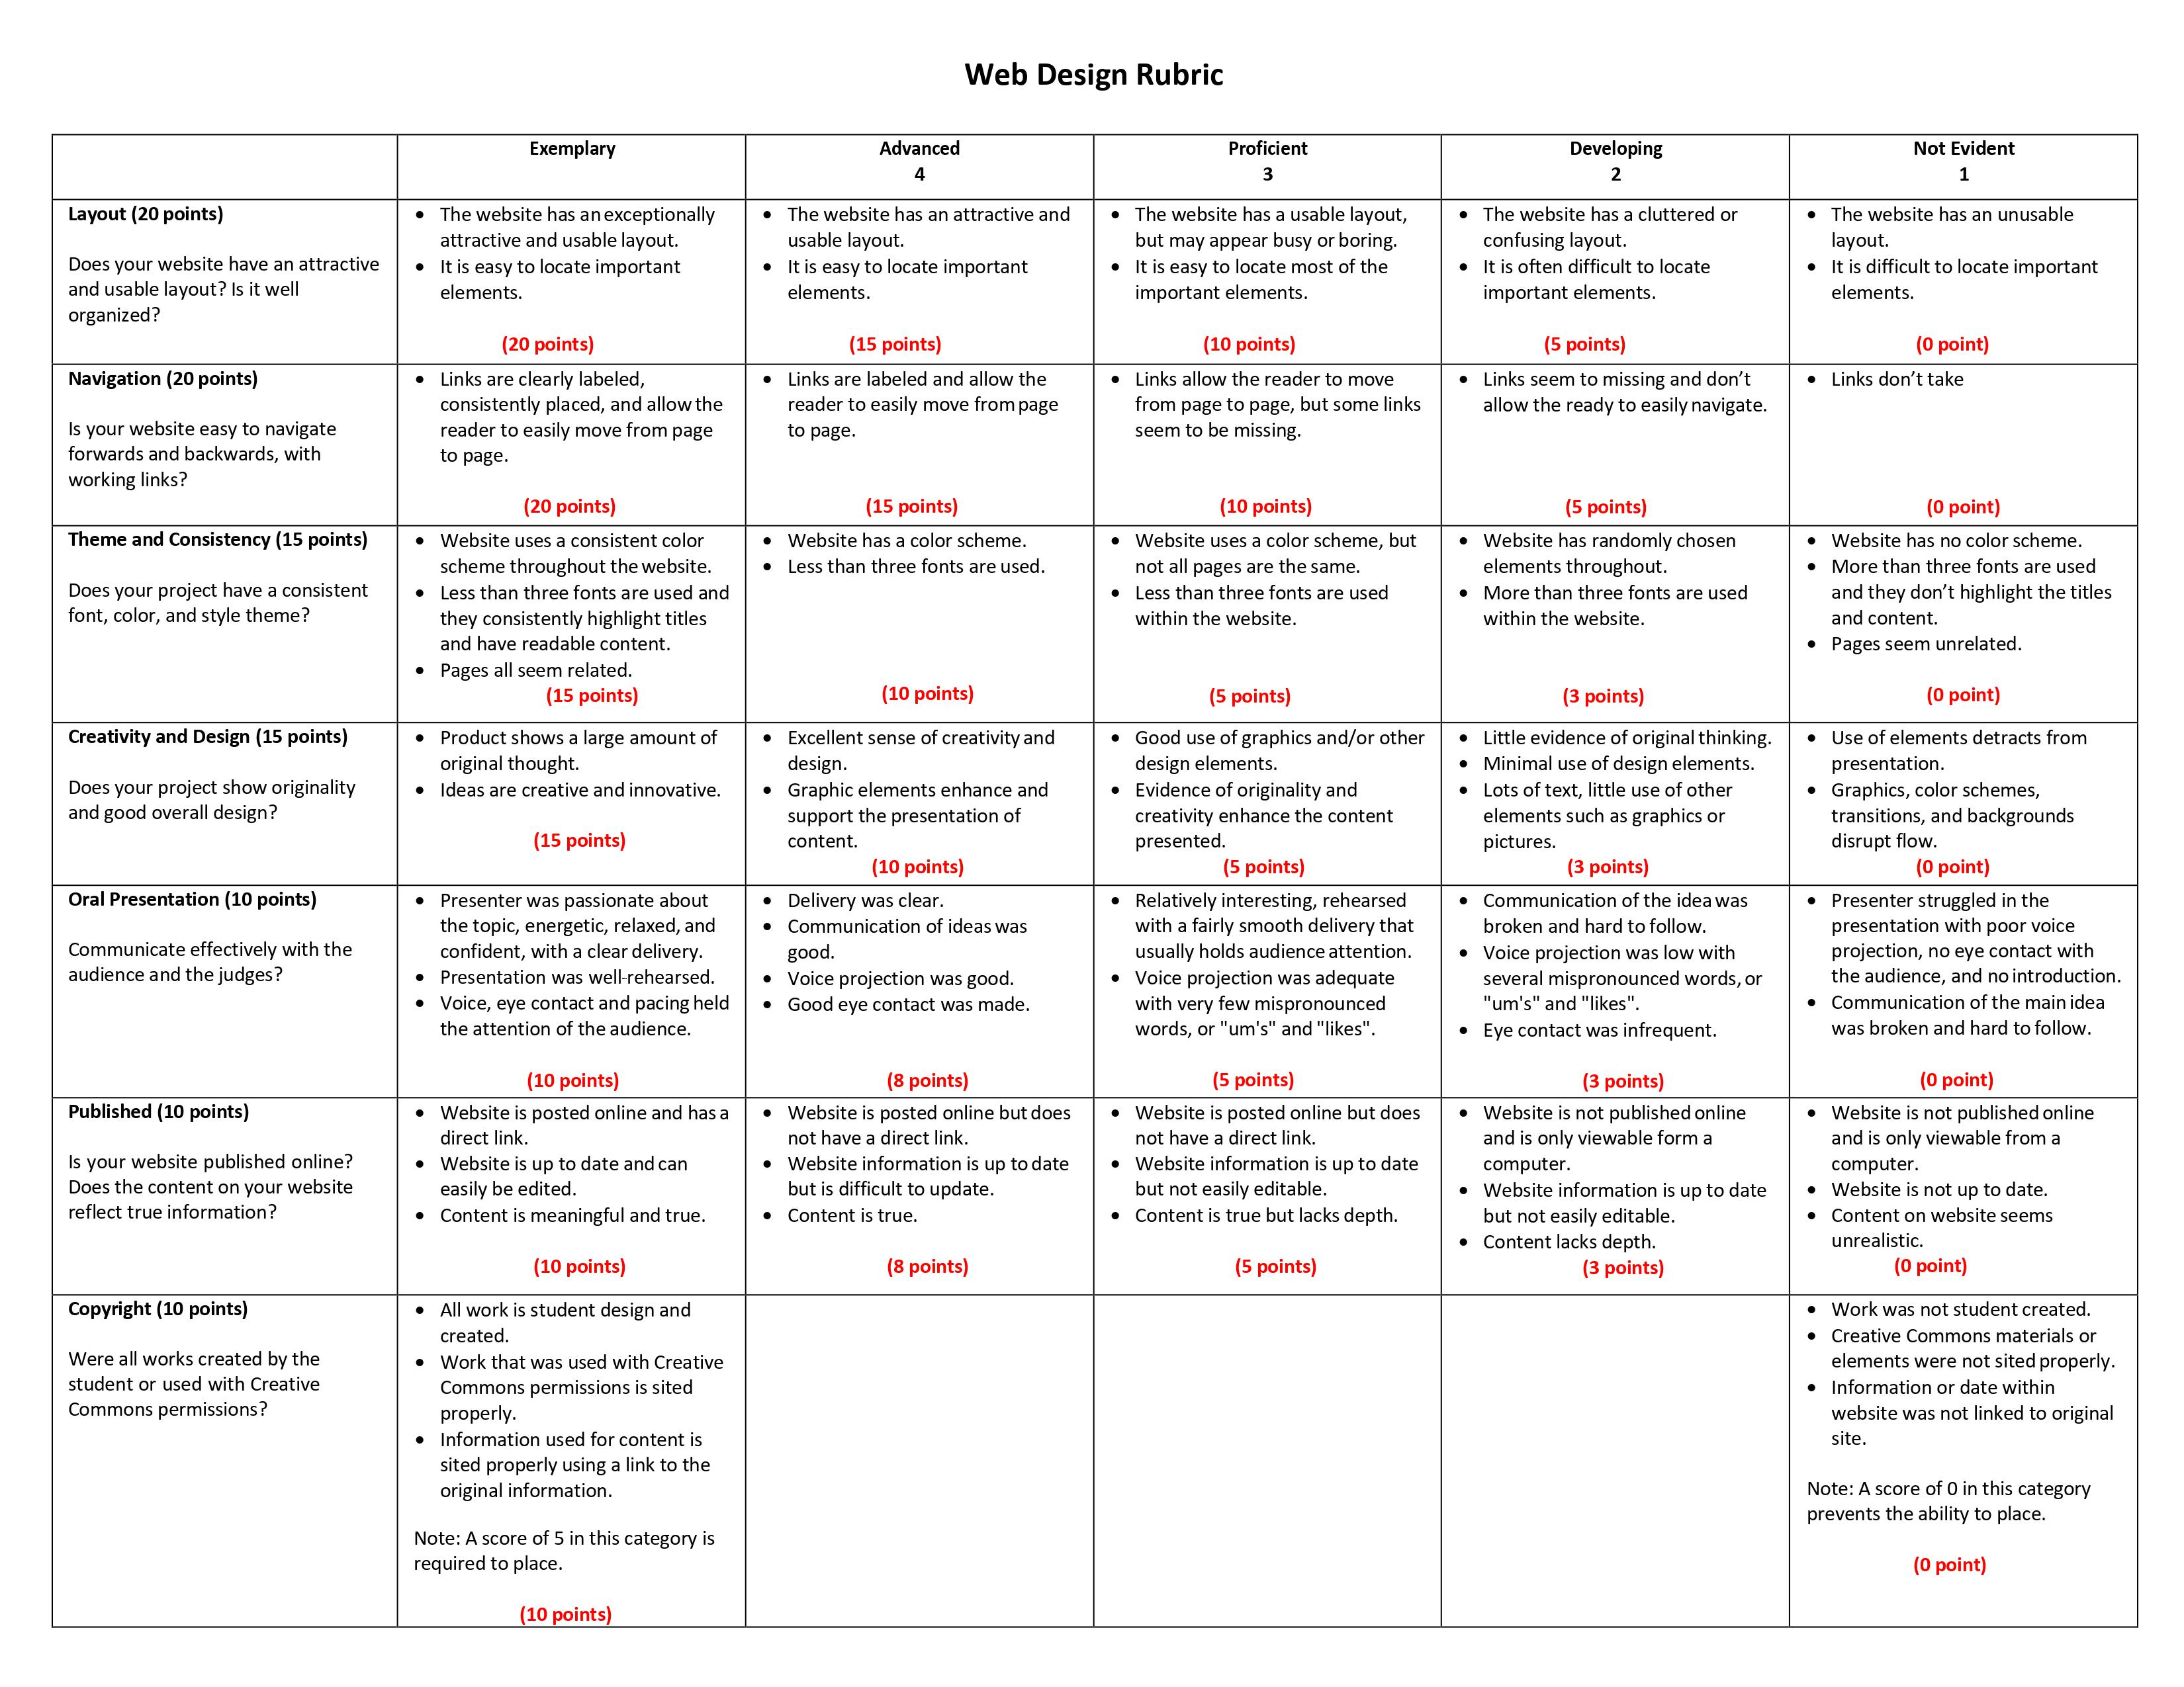

Slide 16
Project Link
https://poems4u.000webhostapp.com/

